Slide 1
JavaServer Pages (JSP)
ADVJ Session 5 –JSP
1/26

Slide 2
Objectives
JavaServer Pages (JSP)
  What JSP Technology is and how you can use it.
  JSP Page
  Translation Time
  How JSP Works?
  JSP Elements
  JSP Predefined Variable – Implicit Objects
  JSP Lifecycle
ADVJ Session 5 –JSP
<number>/26

Slide 3
Objectives
Dispatching Mechanisms
  <jsp:forward>
  <jsp:include>
JSPs in XML
ADVJ Session 5 –JSP
<number>/26

Slide 4
JavaServer Pages (JSP)
What JSP Technology is and how you can use it.
  JavaServer Pages (JSP) technology provides a simplified, fast way to create web pages that display dynamically-generated content.
  The JSP 1.2 specification is an important part of the Java 2 Platform, Enterprise Edition. Using JSP and Enterprise JavaBeans technologies together is a great way to implement distributed enterprise applications with web-based front ends.
  The first place to check for information on JSP technology is http://java.sun.com/products/jsp/
ADVJ Session 5 –JSP
<number>/26

Slide 5
JSP Page
A JSP page is a page created by the web developer that includes JSP technology-specific tags, declarations, and possibly scriptlets, in combination with other static HTML or XML tags.
A JSP page has the extension .jsp; this signals to the web server that the JSP engine will process elements on this page.
Pages built using JSP technology are typically implemented using a translation phase that is performed once, the first time the page is called. The page is compiled into a Java Servlet class and remains in server memory, so subsequent calls to the page have very fast response times.
ADVJ Session 5 –JSP
<number>/26

Slide 6
Translation Time
A JSP application is usually a collection of JSP files, HTML files, graphics and other resources.
A JSP page is compiled when your user loads it into a Web browser
When the user loads the page for the first time, the files that make up the application are all translated together, without any dynamic data, into one Java source file (a .java file)
The .java file is compiled to a .class file. In most implementations, the .java file is a Java servlet that complies with the Java Servlet API.
ADVJ Session 5 –JSP
<number>/26

Slide 7
Simple JSP Page
<HTML>
<H1> First JSP Page </H1>
<BODY>
<%
out.println(“Welcome to JSP world”);
%>
</BODY>
</HTML>
ADVJ Session 5 –JSP
<number>/26

Slide 8
How JSP Works?
User Request – JSP File Requested
Server
File
Changed
Create Source from JSP
Compile
Execute Servlet
ADVJ Session 5 –JSP
<number>/26

Slide 9
JSP Elements
Declarations
  <%! code %>
Expressions
  <%= expression%>
Scriplets
<% code %>
ADVJ Session 5 –JSP
<number>/26

Slide 10
HTML Comment
Generates a comment that is sent to the client.
  Syntax
  <!-- comment [ <%= expression %> ] -->
  Example:
<!-- This page was loaded on
  <%= (new java.util.Date()).toLocaleString() %>
  -->
ADVJ Session 5 –JSP
<number>/26

Slide 11
Declaration
Declares a variable or method valid in the scripting language used in the JSP page.
  Syntax
  <%! declaration; [ declaration; ]+ ... %>
  Examples
  <%! String destin; %>
  <%! public String getDestination()
  {return destin;}%>
  <%! Circle a = new Circle(2.0); %>
  You can declare any number of variables or methods within one declaration
  element, as long as you end each declaration with a semicolon.
  The declaration must be valid in the Java programming language.
ADVJ Session 5 –JSP
<number>/26

Slide 12
Declaration Demo
Demo\JSP1\dec.jsp
ADVJ Session 5 –JSP
<number>/26

Slide 13
Expression
Contains an expression valid in the scripting language used in the JSP page.
  Syntax
  <%= expression %>
  <%! String name = new String(“JSP World”); %>
  <%! public String getName() { return name; } %>
  <B><%= getName() %></B>
  Description:
  An expression element contains a scripting language expression that is evaluated, converted to a String, and inserted where the expression appears in the JSP file.
  Because the value of an expression is converted to a String, you can use an expression within a line of text, whether or not it is tagged with HTML, in a JSPfile. Expressions are evaluated from left to right.
ADVJ Session 5 –JSP
<number>/26

Slide 14
Expression Demo
Demo\JSP1\exp.jsp
ADVJ Session 5 –JSP
<number>/26

Slide 15
Scriptlet
Contains a code fragment valid in the page scripting language.
  Syntax
  <% code fragment %>
  <%
  String var1 = request.getParameter("name");
  out.println(var1);
  %>
This code will be placed in the generated servlet method:
  _jspService()
ADVJ Session 5 –JSP
<number>/26

Slide 16
Scriplet Demo
Demo\JSP1\scriptlet.jsp
ADVJ Session 5 –JSP
<number>/26

Slide 17
JSP Predefined Variable – Implicit Objects
request – Object of HttpServletRequest (request parameters, HTTP headers, cookies
response – Object of HttpServletResponse
out - Object of PrintWriter buffered version JspWriter
session - Object of HttpSession associated with the request
application - Object of ServletContext shared by all servlets in the engine
config - Object of ServletConfig
pageContext - Object of PageContext in JSP for a single point of access
page – variable synonym for this object
ADVJ Session 5 –JSP
<number>/26

Slide 18
JSP Lifecycle
Servlet from JSP
jspInit()
Init Event
jspService()
Request
Response
jspDestroy()
Destroy Event
ADVJ Session 5 –JSP
<number>/26

Slide 19
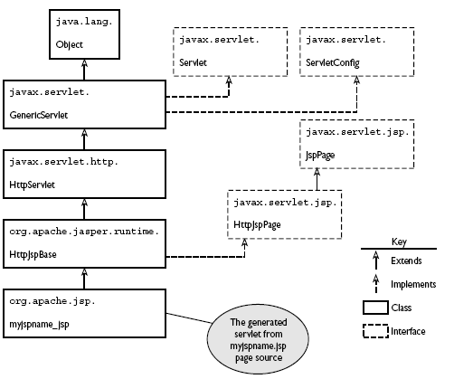
Class Hierarchy Generated Servlet
ADVJ Session 5 –JSP
<number>/26

Slide 20
JSP Directives
Directives, which—like scripting elements—are pieces of JSP tag-like syntax. Like an XML or HTML tag, directives have attributes that dictate their meaning and effect. In almost all cases, the effects produced by directives can’t be replicated using expressions, scriptlets, or declarations.
We’ll consider the three directives:
  page,
  include,
  and taglib.
ADVJ Session 5 –JSP
<number>/26

Slide 21
The page Directive
You can include a page directive anywhere in your JSP page source: beginning, middle, or end.
An example of how one looks:
  <%@ page attributeName=“value" %>
ADVJ Session 5 –JSP
<number>/26

Slide 22
The page Directive-import attribute
Import attribute
  Use the import attribute to create import statements in the generated servlet source produced by the JSP container’s translation phase.
  Example:
  <%@ page import="java.util.StringTokenizer" %>
JSP Container will import 04 packages at translation time:
  javax.servlet
  javax.servlet.http
  javax.servlet.jsp
  java.lang
ADVJ Session 5 –JSP
<number>/26

Slide 23
The page Directive - contentType attribute
The value of the contentType attribute is a String that specifies the MIME type of the response to be sent back.
<%@ page contentType="image/gif" %>
<%@ page import="java.io.*" %>
<% /* response.setContentType("image/gif"); */
String path = getServletContext().getRealPath("tomcat.gif");
File imageFile = new File(path);
long length = imageFile.length();
response.setContentLength((int) length);
OutputStream os = response.getOutputStream();
BufferedInputStream bis =
new BufferedInputStream(new FileInputStream(imageFile));
int info;
while ((info = bis.read()) > -1) {
os.write(info);
}
os.flush();
%>
ADVJ Session 5 –JSP
<number>/26

Slide 24
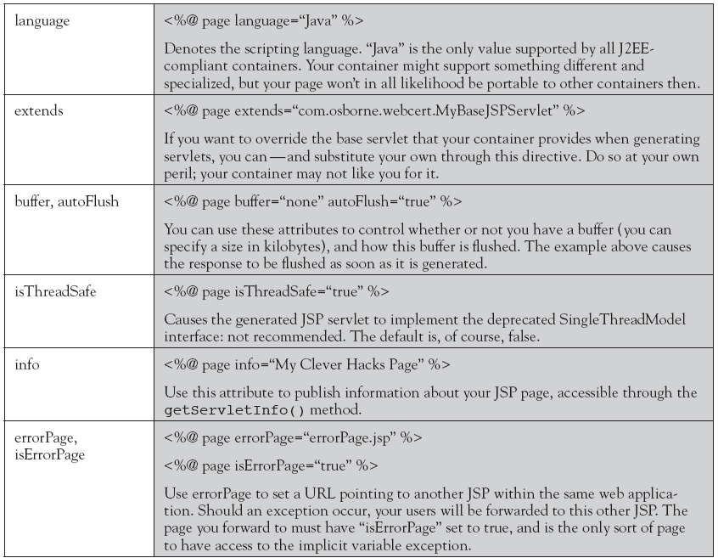
Other attributes of the page directive
ADVJ Session 5 –JSP
<number>/26

Slide 25
The include Directive
A JSP source file and the pages it includes through the include directive are collectively referred to as a “translation unit.”
The file type you include doesn’t have to be JSP page source, nor does it have to have a .jsp extension. Once included, the file contents must make sense to the JSP translation process, but this gives scope to include entire HTML or XML documents, or document fragments.
ADVJ Session 5 –JSP
<number>/26

Slide 26
The include Directive…
<%@ include file=“relativeURL " %>
<html>
<body>
<%@ include file="header.jsp" %>
<h1>Including Page</h1>
<%@ include file="footer.html" %>
</body>
</html>
ADVJ Session 5 –JSP
<number>/26

Slide 27
The taglib Directive
The taglib directive makes custom actions available in the JSP page by referencing a tag library (will study in the next session).
ADVJ Session 5 –JSP
<number>/26

Slide 28
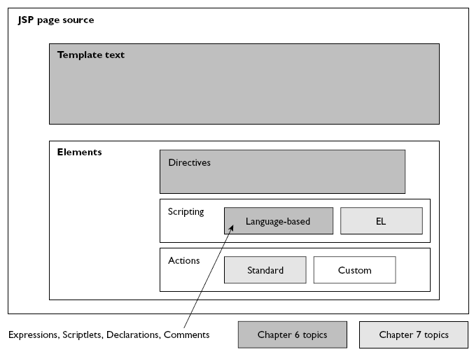
JSP Source Elements
ADV Session 6 – More on JSP
<number>/20

Slide 29
Standard Actions
Standard actions are used for the same purpose as Java language-based scripting: Most if not all the goals that you can achieve with standard actions are achievable with other scripting elements.
So why use them?
  The answer is that they get the job done more elegantly. They often provide an alternative to inserting java code into your neatly designed presentation page.
ADV Session 6 – More on JSP
<number>/20

Slide 30
Standard actions general syntax
<prefix:tagname firstAttribute="value" secondAttribute="value">
...
</prefix:tagname>
ADV Session 6 – More on JSP
<number>/20

Slide 31
Dispatching Mechanism <jsp:include>
The standard action <jsp:include> can be used to include the response from another file within your JSP page output.
You specify the file whose response should be included with the page attribute, like this:
<jsp:include page="pageToInclude.jsp" />
The file whose response should be included has to reside somewhere in your web application but doesn’t have to be present until the page is actually requested.
ADV Session 6 – More on JSP
<number>/20

Slide 32
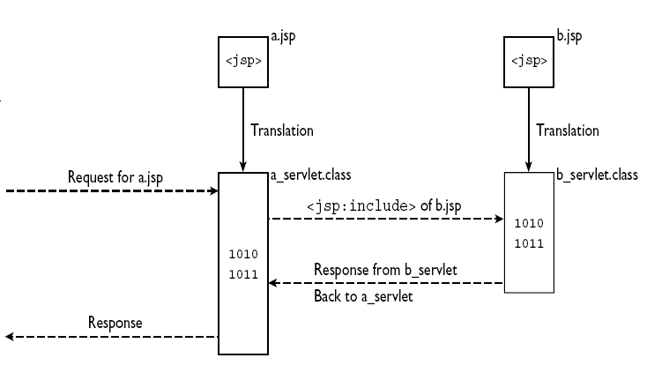
<jsp:include> vs. <%@ include %>
<jsp:include>
ADV Session 6 – More on JSP
<number>/20

Slide 33
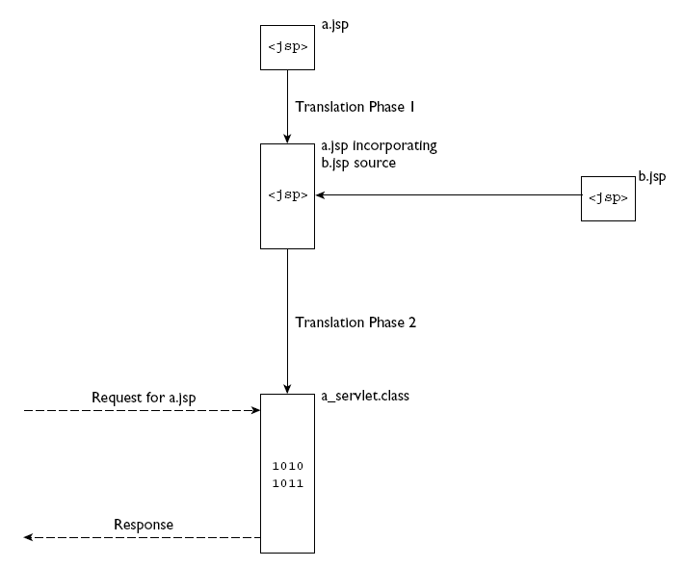
<jsp:include> vs. <%@ include %>
<%@ include %>
ADV Session 6 – More on JSP
<number>/20

Slide 34
Dispatching Mechanism <jsp:forward>
The purpose of this standard action is to forward processing to another resource within the web application.
  <jsp:forward page=“destinationPage">
  <jsp:param name=“.." value=“.." />
  …
  </jsp:forward>
ADV Session 6 – More on JSP
<number>/20

Slide 35
<jsp:forward> demo
http://localhost:8080/stdActions/select.html
ADV Session 6 – More on JSP
<number>/20

Slide 36
Summary
JavaServer Pages (JSP)
  What JSP Technology is and how you can use it.
  JSP Page
  Translation Time
  How JSP Works?
  JSP Elements
  JSP Predefined Variable – Implicit Objects
  JSP Lifecycle
JSP Directives
  The page Directive
  The include Directive
  The taglib Directive
ADVJ Session 5 –JSP
<number>/26

Slide 37
Summary
Dispatching Mechanism
  <jsp:forward>
  <jsp:include>
Q&A
ADV Session 6 – More on JSP
<number>/20

